Slide 1
Entity Component framework of Fools Engine
What are we even talking about?
Work in progress
Entity-Component-System
!=
Entity-Component system
Since a departure from the “Actor” model with inheritance oriented implementation for scene representation in commercial game engines, online tutorials, blog posts, and conference presentations towards the “Entity-Component” framework with a composition oriented approach, implemented in form of generic, runtime dynamic, game agnostic system, term “Entity-Component system” has gained popularity.
This creates a great deal of confusion, as “Entity-Component system” and “Entity-Component-System” (data oriented design pattern sometimes used in those frameworks and a trendy buzzword) can only be differentiated from context. Not to mention improper use of those terms by people not knowing and understanding the difference.
Additionally, scene representation frameworks in different game engines use incompatible fundamental nomenclatures (e.g. GameObject, Pawn, Actor, Entity, Node).

Slide 2
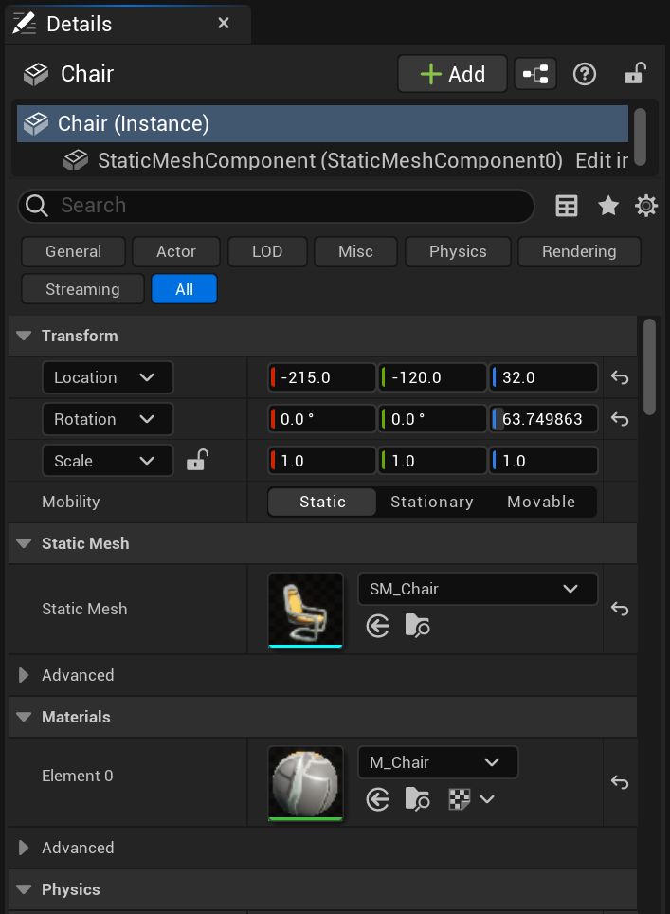
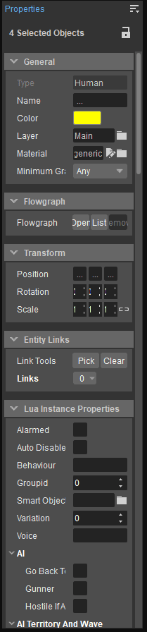
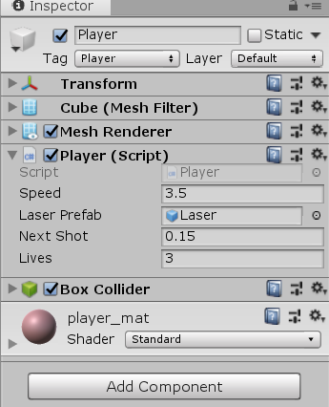
Entity Component framework of Fools Engine
Framework – what do we need it for?
Work in progress
What a framework provides:
The game is built out of "Entities", which themselves are composed of "Components".
Components represent the game.
Components are meant to be reusable.
En engine provides a set of components well integrated with big engine systems.
Entities fulfill the service locator pattern - they can be used to retrieve a child component by type.
Components can be dynamically added to an entity.
The main purpose here is to enable dynamic, runtime composition. Instead of entity types being hard-coded, they can be constructed in the editor, attached to the engine systems (rendering, physics, etc.), serialized, and deserialized without writing a single line of code. This allows designers to create their own, unique kinds of objects.

Slide 3
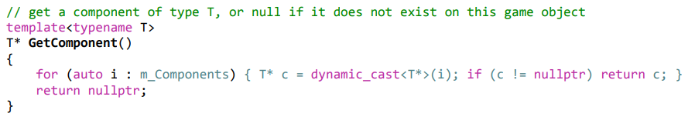
Entity Component framework of Fools Engine
State of the rot – architecture issue
Work in progress
The drawback of this solution is that the core code of the framework is in some sense constructing a whole new meta-language, and a VM to run that meta-language on. The problem is so abstract and generic, that implementing a solution is extremely difficult. A fully elegant one is perhaps impossible, as it requires breaking numerous principles of a good software architecture design.
To name a few examples:
Rampant virtual methods obfuscate both the execution and data flows by breaking the single responsibility principle
The entity’s implementation of the service locator pattern for retrieving components breaks Liskov’s substitute principle
Allowing to retrieve components anywhere in the code creates implicit, unmanageable dependencies
Components rely on inheritance of at least an interface, but also often of implementation what violates composition over inheritance principle

Slide 4
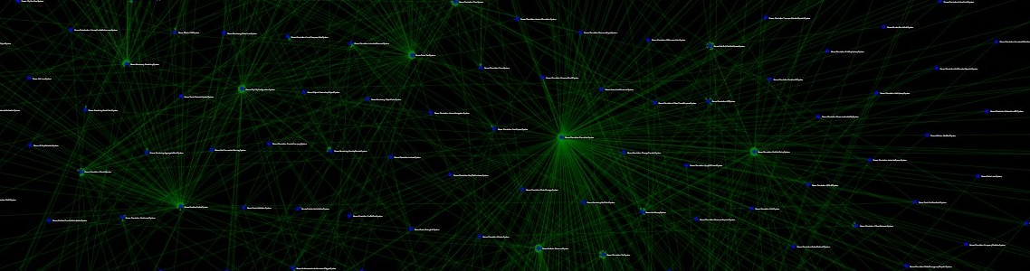
Entity Component framework of Fools Engine
State of the rot – frameworks usability
Work in progress
Game engines typically include 2 interfaces for their scene representation framework:
- for engine build-in systems (rendering, physics, etc.) and systemic game features (crowds, traffic, etc.)
- for unique, high-level gameplay features (player’s character movement, camera control, etc.).
Systems in City Skyline 2
The systemic side often creates implicit dependencies from the get-go and requires specific predefined setups to work, sometimes even as an undocumented technological debt. The gameplay side usually comes in form of scripting (C#, Lua, BluePrints, etc.) with full access to all data of the scene, intended to be used by various types of designers without knowledge of good programming principles and practices, who inevitably end up abusing that access.
Games are complex. That complexity is unavoidable and has to be resolved somewhere. Most entity-component frameworks settle down on a model that supports only a narrow set of design patterns for authoring a game’s logic. That puts all the responsibility and difficulty of managing that complexity on game developers. Their lack of intuitive grasp of the model and its design philosophy leads to misuse and overcomplication, even with a logical understanding of its implementation architecture!

Slide 5
Entity Component framework of Fools Engine
State of the rot – frameworks utilization
Work in progress
Single, from a player’s perspective conceptually indivisible, element of the game (including its behavior) is implemented using multiple components and systems (and potentially entities) with various tricky dependencies between them, but also with their own internal complexities. Games usually have unintuitive execution flows, as a result of this coupling, combined with interactions between systemic and gameplay interfaces. That makes reasoning about game code difficult (sometimes even literally impossible without actually running the game and testing it). Familiarizing yourself with existing game code or simply keeping up with it becomes a very big cognitive load. At the end of the development process, the game is too complex for anyone to know how it works anymore. Pieces of spaghetti code are also sometimes carried over to the next project as black boxes with legacy dragons and get stacked over time like a rotting onion.
But even with proper usage, a simple design of a scene representation framework's execution model causes problems, because it cannot be suitable for all types of features. If it is closed and restrictive, developers will fight it with workarounds and dirty hacks. If it is open, it will cause inconsistencies and will result in a spaghetti of dependencies.

Slide 6
Entity Component framework of Fools Engine
Alternatives – hot loading
Work in progress
Programming languages already come with support for composition as a feature – there is no need for a bloated framework on top to use it. The tricky part is to make it runtime dynamic, but even that is achievable. We could dynamically generate code, compile it into a dll, and hot load it. This approach is impractical for the game’s runtime, but a fully dynamic composition is needed for very few games. The main goal is to enable designers to author objects in the editor during the development process. In this case, we can even simplify things by defining objects using scripting languages instead of the editor’s GUI with complex declarative native code behind it.
That however does not solve the problem at its root. The engine’s core will never be able to use specific object types without an abstract interface over them unless we are willing to auto-generate its code and recompile it too whenever a new type of object appears. And that idea does not sound promising at all. So all the issues we had with the entity-component relation architectural design are now shifted upon a relation between an entity and a specific entity type. Perhaps this is a more elegant approach that would enable greater control over the game’s runtime execution. However, it still does not address the issue of helping with managing the complexity of our entities’ behaviors.

Slide 7
Entity Component framework of Fools Engine
Alternatives - embracing complexity
Work in progress
Complex ≠ Difficult Simple ≠ Easy
Instead of fighting the complexity of a game by denying its existence, we could come to terms with it and accept its inevitability. Acceptance does not mean indifference towards the problem. Instead of pushing the responsibility down to game developers, we could provide them with tools for the proper expression of the game's logic.
Organization and structurization of both data and logic should be the fundamental roles of the scene representation framework. That requires a model that includes a comprehensive set of features for the representation of not only data but also execution flow. The complexity and diversity of its subject are an argument for the complexity of the model! The generality and abstractness of the model are an argument for the complexity of the model!
Putting data and logic in order properly and comprehensively using a framework is an occasion to better conceptualize and optimize game code while keeping it manageable, extendable, and reusable. The diversity of tools available in a framework for that purpose is not a sign of a bad design.
As long as we keep our framework's execution model composed in an intuitive way of standardized, corresponding concepts we can make it as complex as we need.

Slide 8
Entity Component framework of Fools Engine
Design challenges
Work in progress
Volatile
Game development process
Complex
Usability
Users of all levels of familiarity and experience
Multiple users in one project
Both technical and non-technical users
Run-Time
Performant
Hardware scalable
Stable and bug free
Encompassed Data and Logic
Complex
Divers
Densely interdependent
Dynamic
Random
Integration
Engine functionalities
Systemic game features
Unique game features

Slide 9
Entity Component framework of Fools Engine
Goals
Work in progress
Flexible
Favors extendable and modifiable game code
Allows for multiple ways of implementing features
Organizes game code
Intuitive
Provides multiple levels of conceptualization
Has corresponding rules on them
Has predictable execution flow
Favors simple standardized designs patterns
Fully symmetric life-cycle API
Safe
Isolates game features
Has clear rules for data access and dependencies
Resolves execution order dependencies
Prevents initialization order issues
Performant
Build-in extensive parallelization (including engine-game concurrency)
Data oriented
Service oriented (pay for what you need)
Customizable
Unified (engine build-in features and game code)
Does not allow for data races

Slide 10
Entity Component framework of Fools Engine
Overview of existing design patterns
Work in progress
The concept of a scene representation architecture is not new. In fact, it's as old as the concept of a video game itself. Various excellent programmers in the past tackled it and approached it from different perspectives and still do to this day. There are great lessons in their successes and failures.
Entity design
 | inheritance | composition
 |  | unique | universal
Object - OOP
ID only - DOP | N/A
Component design
 | Banned | Allowed | Enforced
Logic
Inheritance
Hierarchical components
Spatial components |  |  | ?
External storage |  |  | ?
Pointer stability
Spatial hierarchy
What is a node | Component (entity should have a single root component)
 | Entity | Hardcoded
 |  | As component | Enforced
 |  |  | Optional
Definition | Parent
 | List of children
 | Siblings as linked list + first child
Reference type | Pointer | To entity
 |  | To component
 | ID
Application of changes | Once per frame (delta accumulation)
 | Instant
Global transform recalculation | Not cached (recalculation upon access)
 | Cashed | Recalculated upon change
 |  | Dirty flag set upon change | Recalculated once per frame
 |  |  | Recalculated upon access if needed
Skeleton's space | Local - translated to global for rendering
 | Global | Fixed
 |  | Recalculated when entity's transform changes
Update calls
Sequential | Per entity
 | Per component | Individual
 |  | Through entity
Concurent | Actor model
 | Relational model | ECS
 |  | "Inverse" ECS
Components storage
Internal
External | Allocated individually
 | Allocated sequentially | Arrays
 |  | Paged vectors
 |  | (Paged) "sparse" vectors
 |  | (Paged) sparse sets
 |  | (Paged) archetypes
Execution order control
Multi-staged | Initialization
 | Simulation

Slide 11
Entity Component framework of Fools Engine
Corner Stones
Work in progress
2 levels of logic: Behavior and System
Behavior deals with object’s internal state
System deals with world’s state
Component update
Mass update of components (ECS style)
Explicit execution flow control
No default update calls from the engine – enrollment always required
A simple way of controlling execution order with 2 levels of control
1 - Simulation stages (big sync-points)
2 - Numerical priorities for update enrolls
Comprehensive feature set
Provides methods to represent every aspect of a scene, including fully independent purely visual features (foliage, particles, etc.)
Different composition/abstraction layers to choose from to implement any game feature in a suitable way
Full isolation within the same conceptual layer
Trivial parallelization of updates and initialization
Component–component data transfer
Object–object data transfer
ECS Storage
Customizable optimizations
Full continuity of a component’s storage (raw pointer iteration)
In frame pointer stability – no reallocation during component / entity creation and deferred destruction
Build-in spatial hierarchy
Fully managed by the engine, hidden from the user
Automated propagation of transform changes
Global transform is always accurate on access
Children are defined as a linked list to avoid additional heap allocations and indirections during hierarchy traversal
Entity-Component-System compliant components storage architecture
Storage structure reflects hierarchy structure (cash-friendly traversal)
Dictates update order (parent => child)

Slide 12
Entity Component framework of Fools Engine
Decisions => hybrid everywhere
Work in progress
Entity
ID only
Some components universally guaranteed and protected (e.g. transform)
Other dynamically added
Component storage
Off-the-shelf solution – EnTT library
Paged sparse sets
Archetype-like customizable optimizations
Execution order control
Multi-staged execution
Explicit per instance update enrolls
Explicit numerical priorities per update enroll for finer control
Spatial hierarchy
Update calls
Entity is a node stored as a component
Concurrent – hybrid
Definition: siblings as linked list + first child + parent
Reference as ID
Application of changes: instant
Global transform: cashed, recalculated upon access if needed (dirty flag)
Skeleton space: local
No caching of global transforms of special components
Actor model:
Actor is a subsection of the entities’ hierarchy representing a single object (car, NPC, etc.)
Actors are updated in the order defined by the hierarchy
Internal execution of an actor is sequential using Behaviors that operate on components
Component
Logic allowed and not enforced, banned referencing other components/entities – black box with no dependencies
Inheritance enforced (basic types)
Hierarchical components not available
Spatial components allowed
External storage allowed, but discouraged
Pointer stability in frame, but not across frames – deferred destructions
Relational model (ECS)
Further inheritance allowed, but considered as independent types

Slide 13
Entity Component framework of Fools Engine
Structure overview
Work in progress
World
Actor
Mostly data, but can have logic
Dependence free
Subsection of hierarchy of entities
Dependance free
Component
Entity
Abstract container for components
Organized in a hierarchy
Examples: players character, car, NPC
Examples: head, main body, weapon
Examples: animation graph, skeletal mesh
World
Separation of indifferent domains
Scene
Specialization of storage structure
Different levels/maps in game
Examples: gameplay, particles, foliage
Root Entity
Head Entity
Entity
Entity
Entity
Head Entity
Entity
Head Entity
Entity
Entity
Entity
Entity
Entity
Actor
Actor
Actor

Slide 14
Entity Component framework of Fools Engine
Execution and data routing
Work in progress
System
System
Behavior
Execution flow control of dependent Components
Component–component data transfer
Actor’s “internal system” – owned by Actor
Examples: animation, characterController
Uses direct component references (entity IDs)
System
Global – owned by World
2 roles:
Components update (ECS style)
It can be an opt-in or opt-out service
Examples: AI stim system, crowd sim system
Actor-actor data transfer by state injection (similarly to messages in the actor model)
Actors update is an update of its behaviors
2 roles:
Can use direct component references (entity IDs)
Opt-in can be direct or using an empty flag component and permanent or one-time
Systems register for update from the world
Behaviors register for update from Actor
Actor
Actor
Component
Component
Component
Component
Component
Component
Component
Component
Actor
Behavior
Execution
Component
Component
Data transfer
Component
Component

Slide 15
Entity Component framework of Fools Engine
Update Order
Work in progress
Frame Start | Pre-Physics | Physics | Post-Physics | Frame End | Post Frame
Actors
Systems
Actors
Systems
Actors
Systems
Actors
Systems
Actors
Systems
Engine
System
Parallel workload
Parallel workload
Parallel workload
System
Parallel workload
Parallel workload
System
Parallel workload
Parallel workload
System
System
Worker 1
Worker 2
Worker 3
Worker 4
Actor
Actor
Actor
Actor
Actor
Actor
Actor
Actor
Actor
Actor
Actor
Actor
Actor
Actor
Actor
Actor
Actor
Actor
Actor
Actor
Actor
Actor
Actor
Actor
Actor
Actor
Actor
Actor
Actor
Actor
Actor
Actor

Slide 16
Entity Component framework of Fools Engine
Component
Work in progress
Basic building block
Can have data
Can have logic
Mostly utility methods for operating on that component
Can have resource references
Can restrict access to its internal state and expose getters and setters
Can perform its own update, but engine does not provide update call
Stored in global ECS storage
If inherits from another component they are considered as unrelated types
Only one instance of a given component type per one EntityID in global storage
Can have logic
Can be updated by a Behavior or a System (directly or by a call)
Cannot reference anything in the scene (“black box”)
Types
Life Cycle
Unloaded
Load
Unload
Loading
Unload
Unload
Loaded
Loading Failed
Component
FlagComponent Empty Struct
DataComponent Standard
SpacialComponent Adds transform offset
ProtectedComponent Not retrievable (engine managed)
Shutdown
Startup
Active

Slide 17
Entity Component framework of Fools Engine
Entity
Work in progress
Scene Hierarchy
Defined by dedicated component – HierarchyNode
Used to organize storage of some components (e.g. Tags, HierarchyNode, Transforms) for cash friendly traversals
All Entities in a Gameplay World are part of one spatial hierarchy
Fully managed by engine
Children defined as linked list
Children are sorted by their EntityID
Cashes information about its hierarchy depth and children count
Entity class
Thin wrapper around World* and EntityID acting as a handle
Provides utility API for operating on components of an Entity
Provides additional handles and API to protected components responsible for carrying out functionalities of the whole model (e.g. Transform, HierarchyNode)
Abstract container for Components
Abstract container for conceptually/spatially connected components
Is represented in memory as uint32_t - EntityID
EntityID acts as a storage access key to components of an Entity
Can contain only 1 instance of each component type
Every Entity has LocalTransform, GlobalTransform, EntityName, HierarchyNode and Tags components
Unique EntityIDs
NullEntityID != 0, but constexpr
RootEntityID = 0

Slide 18
Entity Component framework of Fools Engine
Actor
Work in progress
Update of all Actors is a multithreaded graph search of scene hierarchy
Actors are updated by the engine in order defined by a special hierarchy (parent => child) to ensure the correctness of Transform changes propagation
Actor update is an update of all it’s Behaviors
Behavior
Updates Component instances in a single Actor
Facilitate control of data and execution flow between Components
Can have properties and transient run-time state
Update
Cannot be referenced by anything – nothing else knows about it’s existence
Actor class
Thin wrapper around Entity class
Provides utility API for operating on Behaviors, Entities and Components constituting an Actor
An Actor’s hierarchy is maintained in parallel to Entities hierarchy as a simplified, collapsed version
Owns and manages Behaviors
Provides Update calls to Behaviors
Abstract object
Abstract object representing single “thing” from players perspective (e.g. players character, NPC, vehicle)
Resolves execution order dependencies between Behaviors within each simulation stage using numerical priorities
Caches a dedicated list of Behaviors and their overridden Update methods enrolled for update per each simulation stage
Uses a subsection of hierarchy of Entities for storing it’s Components
Stores it’s own data in an ActorData Component in a HeadEntity

Slide 19
Entity Component framework of Fools Engine
System
Work in progress
Roles
Execution
Actor-Actor communication using state injection (similarly to messages in actor model)
Global – owned by World
World resolves execution order dependencies between Systems within each simulation stage using numerical priorities
Systems register for update during a particular frame simulation stage (can register for multiple stages)
System cannot reference other systems
Systems can parallelize internally their workload
Systems are executed sequentially by a World
2 roles:
Operates as a service for actors (behaviors and components):
Updating multiple instances of the same Component type (ECS style)
Can be an opt-in or opt-out service
Enrollment can be direct or using FlagComponent
Enrollment can be permanent or one-time
Systems have internal locks to resolve concurrent accesses from Actors
World caches a dedicated list of Systems and their overridden Update methods enrolled for update per each simulation stage

Slide 20
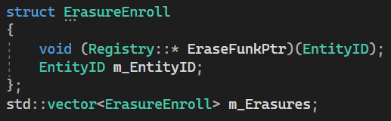
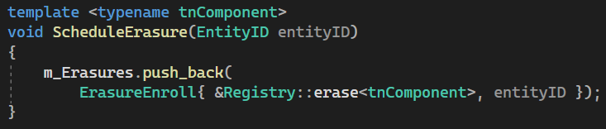
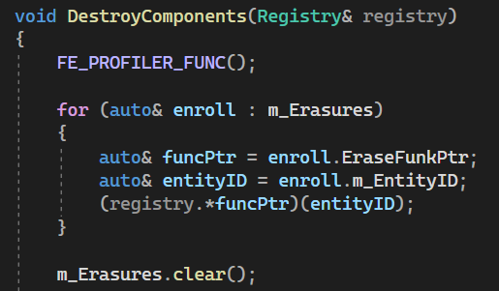
Entity Component framework of Fools Engine
Deletions
Work in progress
Component Destruction
Pointer stability issue
Deletion of a Component (and by so also deletion of Entities and Actors) causes reshuffling of other Components of the same type in memory - invalidation of pointers and references
All deletions has to be deferred to the end of the frame to achieve in-frame pointer stability
Deferring
Actors – deletion handled as deletion of underlying Entities
Behaviors and Systems are not affected by this issue, as they do not reside in ECS storage
Entities – marking with DestroyFlag component
Components – enrolling for destruction in a buffer of EntityIDs and pointers to destruction method applicable for given type of component
Component deletion is handled first, then Entities, as they may relate to the same components

Slide 21
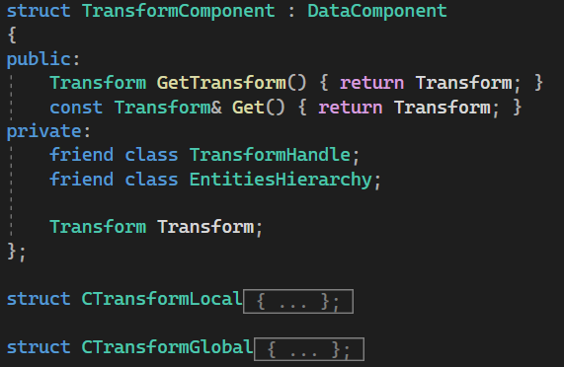
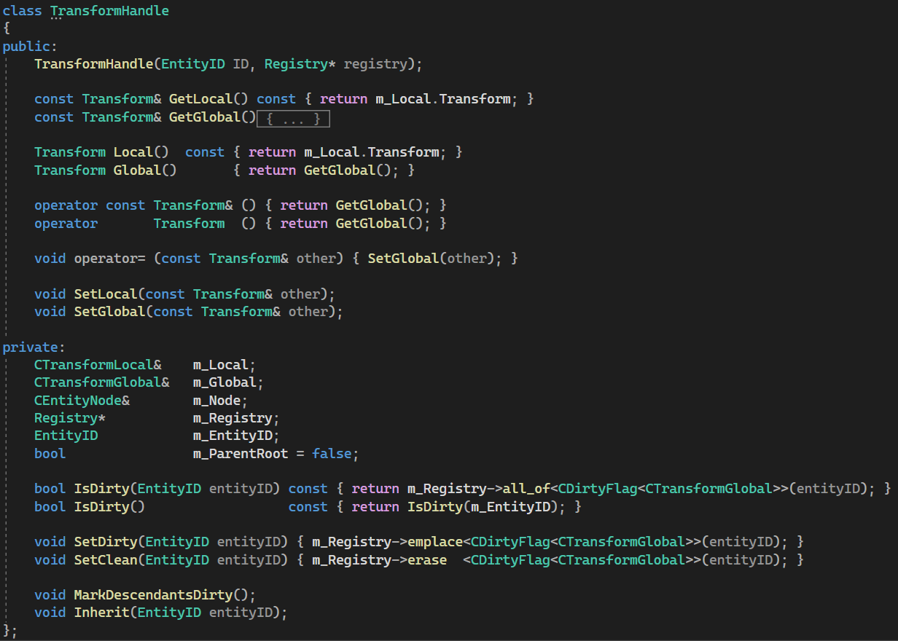
Entity Component framework of Fools Engine
Transform
Work in progress
State Propagation
DirtyFlag component
Marks Global part as „outdated”
Two components: Global and Local
Global is recalculated upon access if necessary (if marked as „dirty”) using hierarchy chain starting from closest „clean” ancestor
Emplaced in all descendant Entities upon Global modification (Local modification implies Global modification)
Local is always accurate, Global appears as always accurate
Availability
Not accessible directly
this->Global = parent->Global + this->Local
Special handle provides safe interface to operate on either Local or Global part
Overloaded operators allowing to treat it as if it was Global aspect of the component itself
Local recalculated upon change, Global recalculated upon access if needed (has changed)

Slide 22
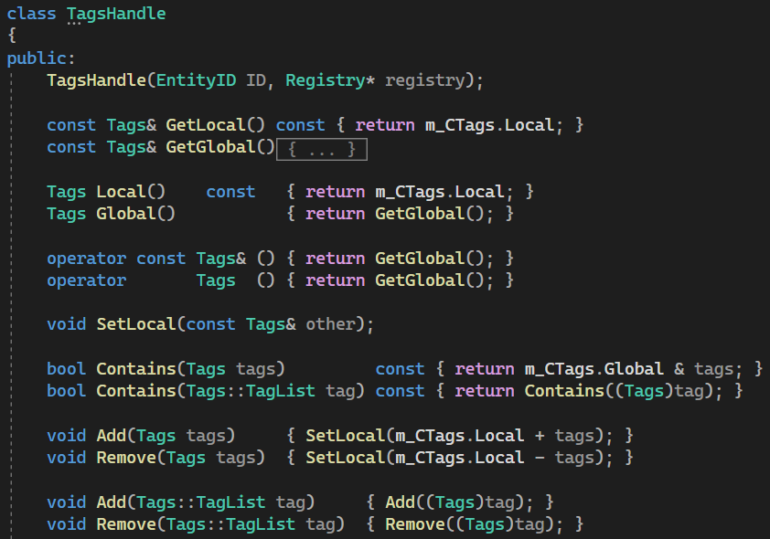
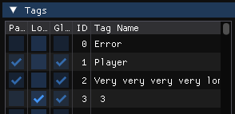
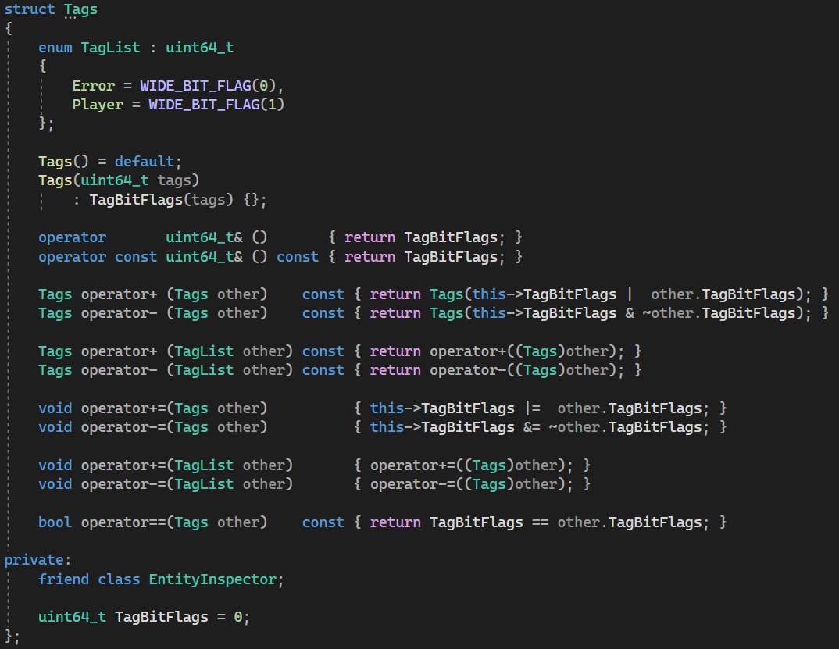
Entity Component framework of Fools Engine
Tags
Work in progress
Tags can be inspected end easily edited in level editor
Propagation
Two parts: Global, Local (in one component)
this->Global = parent->Global + this->Local
Just uint64_t with bit flags - each bit flag represents an existence of a given tag
Tags
Meant to be used to easily recognize given Entity’s purpose and conceptual identity
Should not be used to send info down the hierarchy, unless widely used
Entity class provides utility methods, like FindTagOrigin()
Propagates down the hierarchy the same way as Transform and has similar handle, but triggers full recalculation upon each change

Slide 23
Entity Component framework of Fools Engine
Hierarchy Storage
Work in progress
Order of Components in storage reflects logical structure of the hierarchy
Siblings are grouped next to each other
Siblings are sorted based on their EntityID (logically in linked list of Components and in storage)
Groups of siblings are grouped based on their hierarchy level
Groups of siblings on the same hierarchy level are sorted based on their parent EntityID
Storages of hierarchy related components are synchronized: EntityNode, LocalTransform, GlobalTransform, Tags
Root
Lvl 1
Lvl 2
0 | 3 | 7 | 16 | 31 | 6 | 19 | 18 | 45 | 46 | 33 | 37
Maintenance
This order is not fully guaranteed, as maintaining it at all times would be too expensive
Instead it is recreated once per frame after the simulation and before rendering
It’s purpose is to make hierarchy traversal more cash friendly
Sorting algorithm
Sorting is first performed on an array of just EntityIDs and then resulting permutation applied to component storages in linear time (sorting does not swap components unnecessarily)
Sorting is performed in 2 stages:
1: QuickSort groups each hierarchy level recursively
2: Each level is then sorted concurrently with std::sort
Continuous, amortized approach is still considered

Slide 24
Entity Component framework of Fools Engine
Storage Customization
Work in progress
Grouping components
Limitations
Storages of component types managed by a Group lose pointer stability upon component creation
They cannot be created by Actors (concurrently running Actor’s pointers and references to it’s own components will get invalidated) – creation should happen within a global system
They cannot be accessed using CompPtr (automated cashing of component pointer within one frame) – go through registry/group using raw EntityID each time
Work in progress
Work in progress
EntityHierarchy related Components (e.g. Transforms, Tags, EntityNode) are already grouped
Protected Components cannot be included in a Group (e.g. ActorData, Tags)
Actor related Components (ActorData, ActorNode) are already grouped
Custom Storage
Limitations
Custom storage cannot be involved in a Group
Work in progress
Work in progress
Work in progress
Work in progress
ECS implementation
Current implementation of ECS storage is an external open-source library EnTT
It provides additional customization features like Groups (synchronizing orders of components) and custom component Storages (accessed through storage ID, not type)
Direct usage of those customizations can result in breaking of fundamental design corner stones of the framework
Proper integration of those is not yet designed

